Slide 1
Knowledge Graphs: KG Completion
with Embeddings

Slide 2
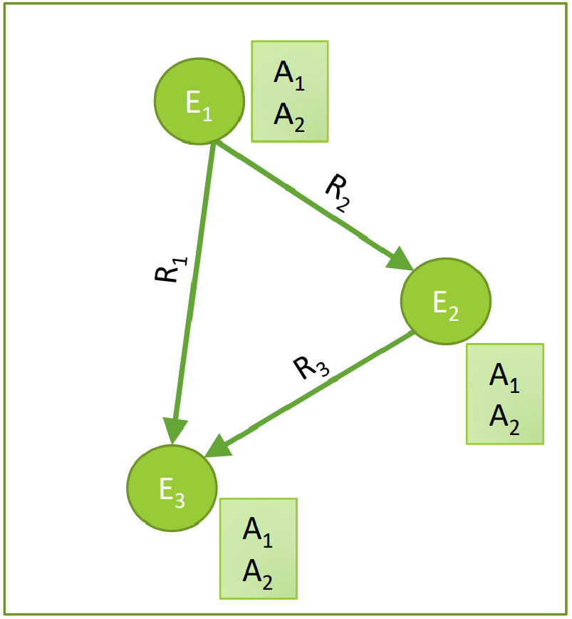
Knowledge in graph form:
Capture entities, types, and relationships
Nodes are entities
Nodes are labeled with their types
Edges between two nodes capture relationships
between entities
KG is an example of a heterogeneous graph

Slide 3
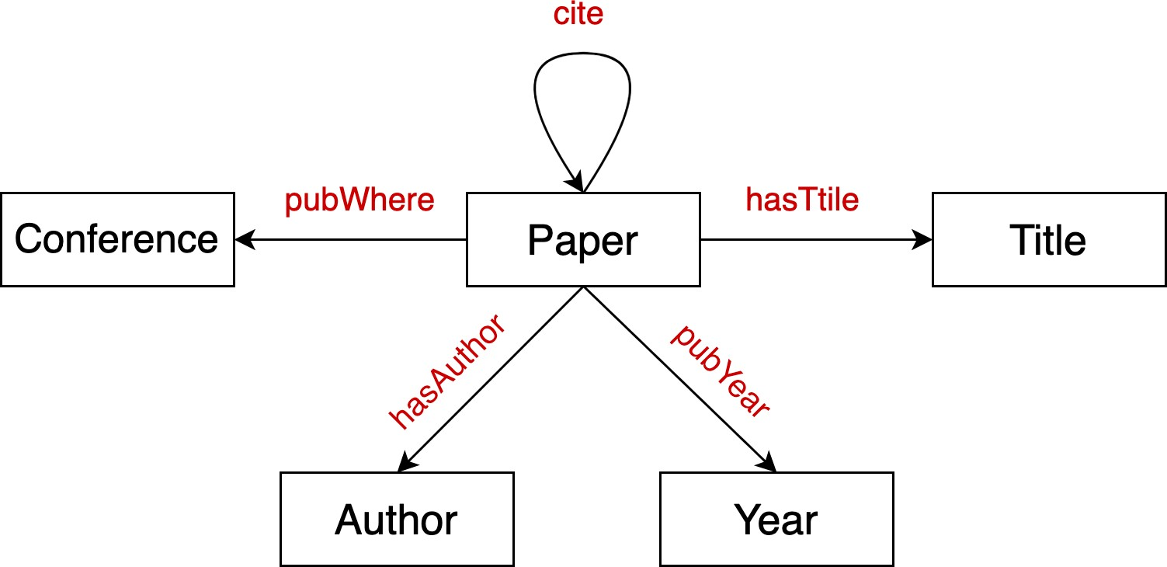
Node types: paper, title, author, conference, year
Relation types: pubWhere, pubYear, hasTitle, hasAuthor, cite

Slide 4
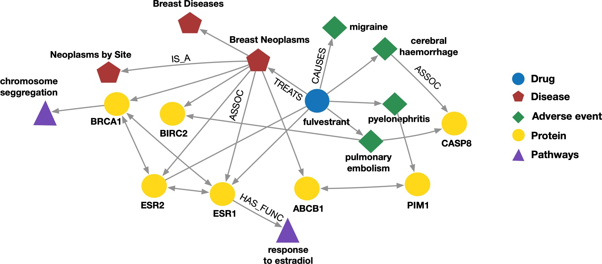
Node types: drug, disease, adverse event, protein, pathways
Relation types: has_func, causes, assoc, treats, is_a

Slide 5
Examples of knowledge graphs
Google Knowledge Graph
Amazon Product Graph
Facebook Graph API
IBM Watson
Microsoft Satori
Project Hanover/Literome
LinkedIn Knowledge Graph
Yandex Object Answer

Slide 6

Serving information
Image credit: Bing

Slide 7
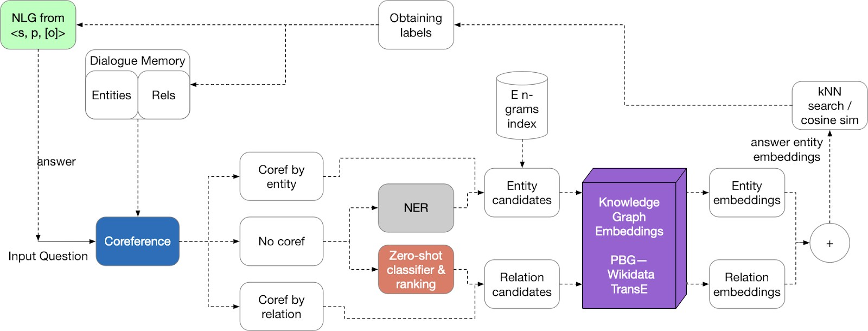
Question answering and conversation agents
Image credit: Medium

Slide 8
Publicly available KGs:
FreeBase, Wikidata, Dbpedia, YAGO, NELL, etc.
Common characteristics:
Massive: millions of nodes and edges
Incomplete: many true edges are missing
Given a massive KG, enumerating all the possible facts is intractable!
Can we predict plausible BUT missing links?

Slide 9


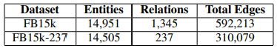
Freebase
~50 million entities
~38K relation types
~3 billion facts/triples
93.8% of persons from Freebase have no place of birth and 78.5% have no nationality!
Datasets: FB15k/FB15k-237
A complete subset of Freebase, used by researchers to learn KG models
Paulheim, Heiko. "Knowledge graph refinement: A survey of approaches and evaluation methods." Semantic web 8.3 (2017): 489-508.
Min, Bonan, et al. "Distant supervision for relation extraction with an incomplete knowledge base." Proceedings of the 2013 Conference of the North American Chapter of the Association for Computational Linguistics: Human Language Technologies. 2013.

Slide 10
Knowledge Graph Completion:
TransE, TransR, DistMul ComplEx

Slide 11

Given an enormous KG, can we complete the KG?
For a given (head, relation), we predict missing tails.
(Note this is slightly different from link prediction task)
J.R.R Tolkien
Science Fiction
missing relation:
genre
Example task: predict the tail “Science Fiction” for (“J.K. Rowling”, “genre”)
genre
genre
Influence
genre
Fantasy
Stephen King
genre
Influence
J.K. Rowling
Influence
Influence
C.S. Lewis
genre
Influence
Alan Poe
Tragicomedy
Lloyd Alexander

Slide 12


Simplest encoding approach: encoder is just an embedding-lookup
embedding vector for a
embedding matrix
specific node
Z =
Dimension/size of embeddings
one column per node

Slide 13

Edges in KG are represented as triples (ℎ, 𝑟, 𝑡)
head (ℎ) has relation 𝑟 with tail (𝑡)
Key Idea:
Model entities and relations in the embedding/vector space ℝ^{d} .
Associate entities and relations with shallow embeddings
Note we do not learn a GNN here!
Given a true triple (ℎ, 𝑟, 𝑡), the goal is that the embedding of (ℎ, 𝑟) should be close to the embedding of 𝑡.
How to embed ℎ, 𝑟 ?
How to define closeness?

Slide 14

Bordes, et al., Translating embeddings for modeling multi-relational data, NeurIPS 2013.
Translation Intuition:
For a triple (ℎ, 𝑟, 𝑡), 𝐡, 𝐫, 𝐭 ∈ ℝ^{d},
𝐡 + 𝐫 ≈ 𝐭 if the given fact is true
embedding vectors will appear in boldface
else 𝐡 + 𝐫 ≠ 𝐭
Scoring function: 𝑓_{r} ℎ, 𝑡 = −||𝐡 + 𝐫 − 𝐭||
𝐫
Nationality Obama
𝐡
𝐭
American

Slide 15
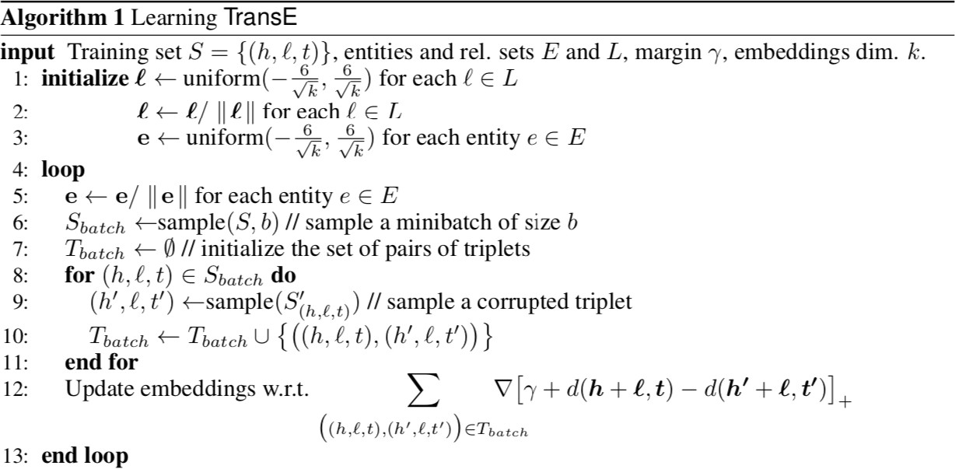
Entities and relations are initialized uniformly, and normalized
Negative sampling with triplet that does not appear in the KG
𝑑 represents distance (negative of score)
positive sample
negative sample
Contrastive loss: favors lower distance (or higher score) for valid triplets, high distance (or lower score) for corrupted ones

Slide 16
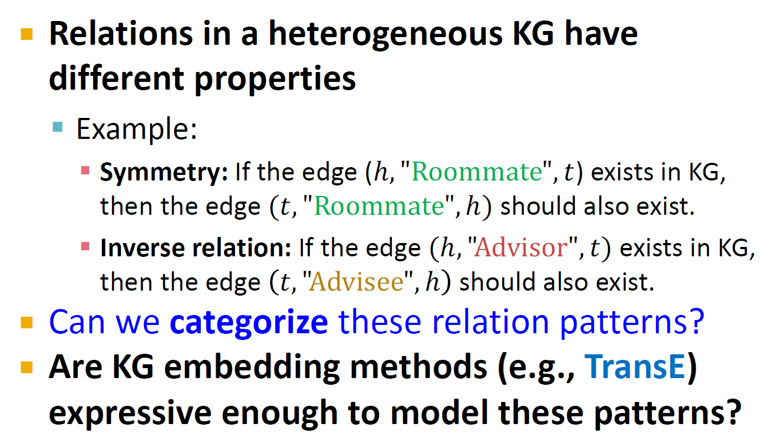

Slide 17

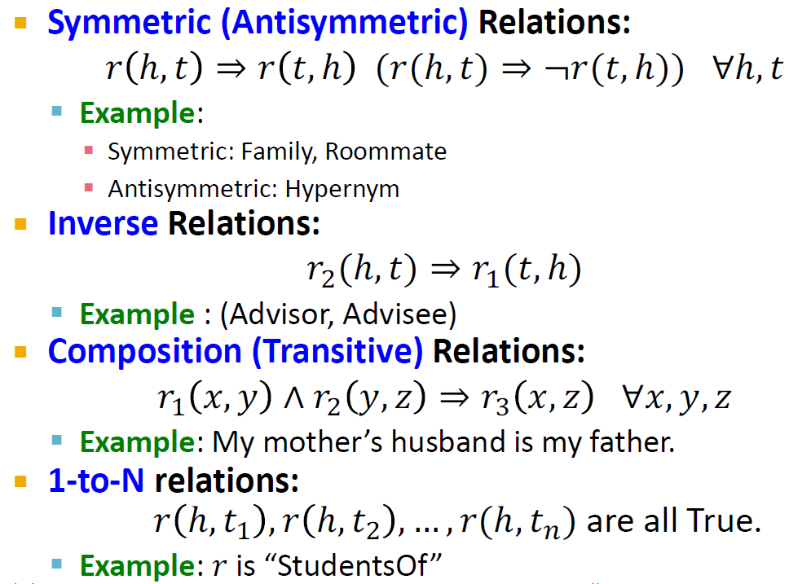
Symmetric (Antisymmetric) Relations:
𝑟 ℎ, 𝑡 ⇒ 𝑟 𝑡, ℎ (𝑟(ℎ, 𝑡) ⇒ ¬𝑟(𝑡, ℎ)) ∀ℎ, 𝑡
Example:
Symmetric: Family, Roommate
Antisymmetric: Hypernym
Inverse Relations:
𝑟₇(ℎ, 𝑡) ⇒ 𝑟₍(𝑡, ℎ)
Example : (Advisor, Advisee)
Composition (Transitive) Relations:
𝑟₍ 𝑥, 𝑦 ∧ 𝑟₇ 𝑦, 𝑧 ⇒ 𝑟₈ 𝑥, 𝑧 ∀𝑥, 𝑦, 𝑧
Example: My mother’s husband is my father.
1-to-N relations:
𝑟 ℎ, 𝑡₍ , 𝑟 ℎ, 𝑡₇ , … , 𝑟(ℎ, 𝑡₉) are all True.
Example: 𝑟 is “StudentsOf”

Slide 18
Antisymmetric Relations:
𝑟(ℎ, 𝑡) ⇒ ¬𝑟(𝑡, ℎ) ∀ℎ, 𝑡
Example: Hypernym
TransE can model antisymmetric relations ✓
𝐡 + 𝐫 = 𝐭, but 𝐭 + 𝐫 ≠ 𝐡
𝐫
𝐫
𝐡
𝐭

Slide 19
Inverse Relations:
𝑟₁(ℎ, 𝑡) ⇒ 𝑟₂ (𝑡, ℎ)
Example : (Advisor, Advisee)
TransE can model inverse relations ✓
𝐡 + 𝑟₁ = 𝐭, we can set 𝑟₁ = −𝐫₂
𝐫_{𝟏}
𝐫_{𝟐}
𝐭
𝐡

Slide 20

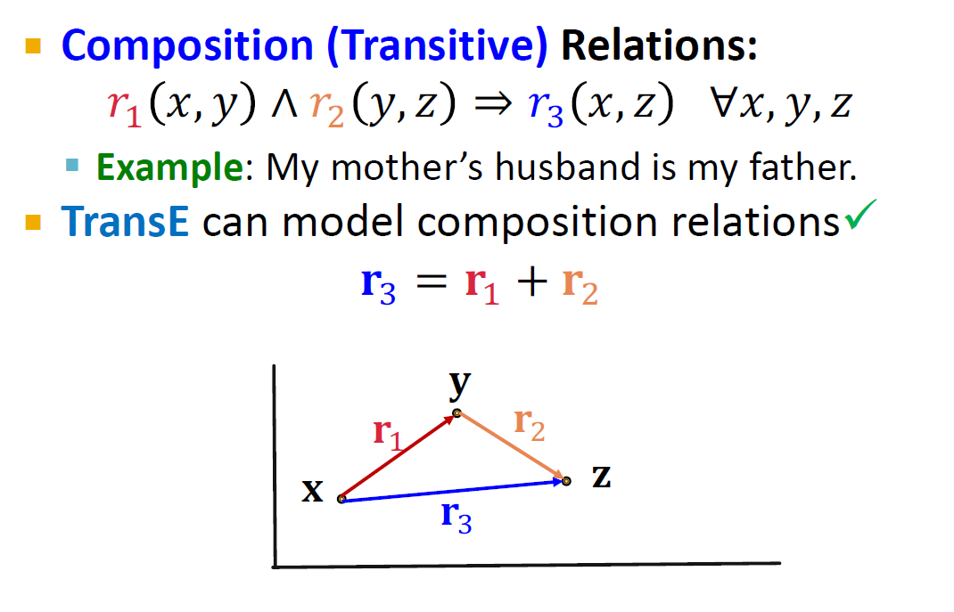
Composition (Transitive) Relations:
𝑟" 𝑥, 𝑦 ∧ 𝑟# 𝑦, 𝑧 ⇒ 𝑟/ 𝑥, 𝑧 ∀𝑥, 𝑦, 𝑧
Example: My mother’s husband is my father.
TransE can model composition relations✓
𝐫/ = 𝐫" + 𝐫#
𝐲
𝐫₍
𝐫₇
𝐱
𝐳
𝐫
8

Slide 21
Symmetric Relations:
𝑟 ℎ, 𝑡 ⇒ 𝑟 𝑡, ℎ ∀ℎ, 𝑡
Example: Family, Roommate
TransE cannot model symmetric relations ✗
only if 𝐫 = 0, 𝐡 = 𝐭
For all ℎ, 𝑡 that satisfy 𝑟(ℎ, 𝑡), 𝑟(𝑡, ℎ) is also True, which means 𝐡 + 𝐫 − 𝐭 = 0 and
𝐭 + 𝐫 − 𝐡 = 0. Then 𝐫 = 0 and 𝐡 = 𝐭,
𝐫
𝐭
however ℎ and 𝑡 are two different entities and should be mapped to different locations.
𝐡

Slide 22
1-to-N Relations:
Example: (ℎ, 𝑟, 𝑡₁) and (ℎ, 𝑟, 𝑡₂) both exist in the knowledge graph, e.g., 𝑟 is “StudentsOf”
TransE cannot model 1-to-N relations ✗
𝐭₁and 𝐭₂ will map to the same vector, although they are different entities
𝐭₁
𝐭₂
𝐫
𝐭₁ = 𝐡 + 𝐫 = 𝐭₂
𝐫
𝐭₁ ≠ 𝐭₂
contradictory!
𝐡

Slide 23

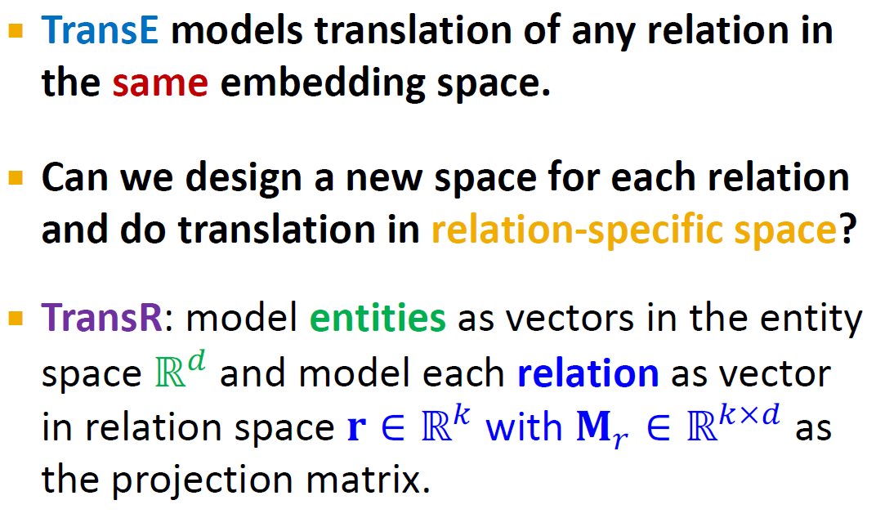
Lin, et al., Learning entity and relation embeddings for knowledge graph completion, AAAI 2015
TransE models translation of any relation in the same embedding space.
Can we design a new space for each relation and do translation in relation-specific space?
TransR: model entities as vectors in the entity space ℝ⁺ and model each relation as vector in relation space 𝐫 ∈ ℝ⁰ with 𝐌! ∈ ℝ^{0×+} as the projection matrix.

Slide 24
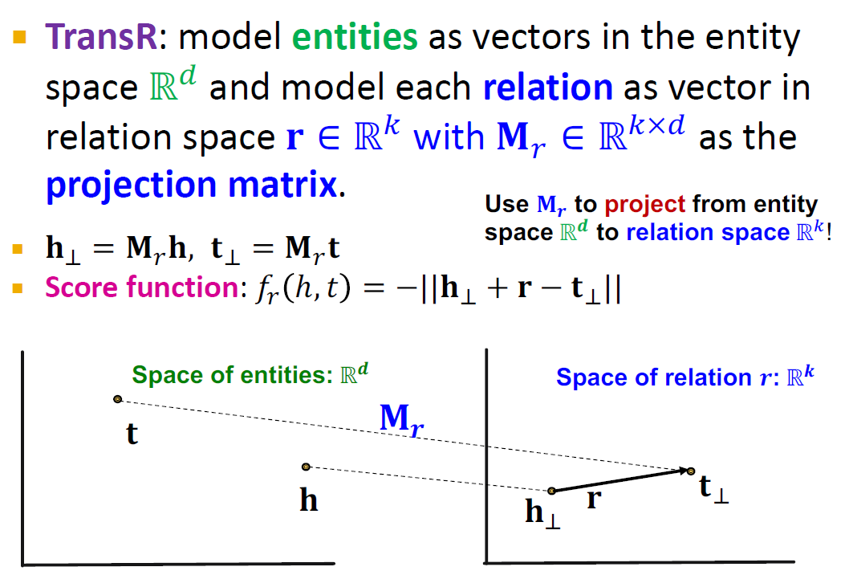
TransR: model entities as vectors in the entity space ℝ⁶ and model each relation as vector in relation space 𝐫 ∈ ℝ⁷ with 𝐌₈ ∈ ℝ^{7×6} as the
projection matrix.
𝐡< = 𝐌/𝐡, 𝐭< = 𝐌/𝐭
Score function: 𝑓/ ℎ, 𝑡
Use 𝐌 to project from entity
𝒓
space ℝ^{𝒅} to relation space ℝ.!
= −||𝐡< + 𝐫 − 𝐭<||
Space of entities: ℝ^{𝒅}
𝐭
𝐡
Space of relation 𝒓: ℝ^{𝒌}
𝐌_{𝒓}
𝐫
𝐭<
𝐡<

Slide 25
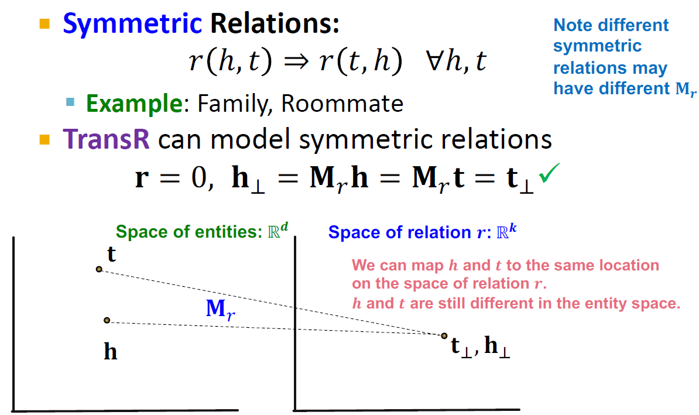
Symmetric Relations:
𝑟 ℎ, 𝑡 ⇒ 𝑟 𝑡, ℎ ∀ℎ, 𝑡
Note different symmetric relations may have different 𝐌_{𝒓}
Example: Family, Roommate
TransR can model symmetric relations
𝐫 = 0, 𝐡₂ = 𝐌!𝐡 = 𝐌!𝐭 = 𝐭₂✓
Space of entities: ℝ^{𝒅}
𝐭
Space of relation 𝒓: ℝ^{𝒌}
We can map 𝒉 and 𝒕 to the same location on the space of relation 𝒓.
𝒉 and 𝒕 are still different in the entity space.
𝐌/
𝐡
𝐭<, 𝐡<

Slide 26
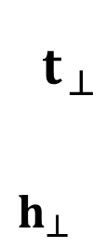
Antisymmetric Relations:
𝑟(ℎ, 𝑡) ⇒ ¬𝑟(𝑡, ℎ) ∀ℎ, 𝑡
Example: Hypernym
TransR can model antisymmetric relations
𝐫 ≠ 0, 𝐌_{r}𝐡 + 𝐫 = 𝐌_{r}𝐭,
Then 𝐌_{r}𝐭 + 𝐫 ≠ 𝐌_{r}𝐭✓
Space of entities: ℝ^{𝒅} Space of relation 𝒓: ℝ^{𝒌}
𝐭
$${\text{t}}_{⊥}$$
$${\text{h}}_{⊥}$$
𝐫
𝐌_{r}
𝐫
𝐡
50

Slide 27
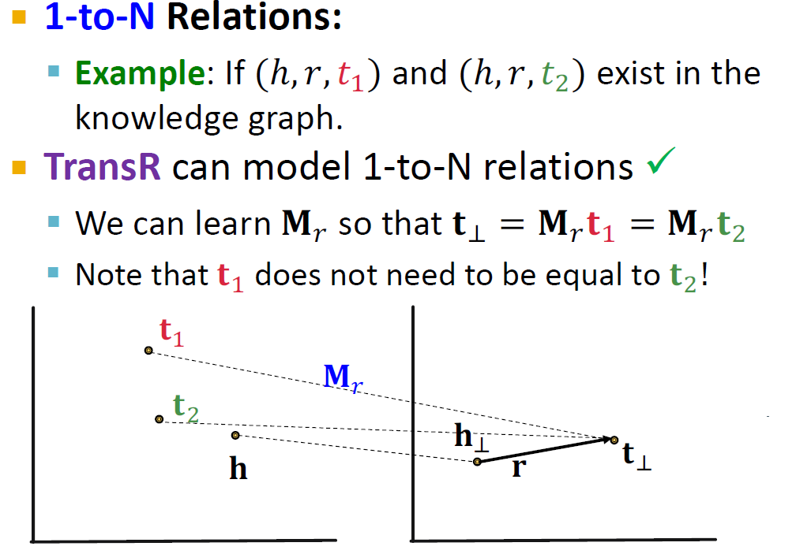
1-to-N Relations:
Example: If (ℎ, 𝑟, 𝑡₍) and (ℎ, 𝑟, 𝑡₇) exist in the knowledge graph.
TransR can model 1-to-N relations ✓
We can learn 𝐌* so that 𝐭< = 𝐌* 𝐭₍ = 𝐌* 𝐭₇
Note that 𝐭. does not need to be equal to 𝐭/!
𝐭₎
𝐌/
𝐭
*
𝐡
<
𝐭<
𝐡
𝐫
51

Slide 28
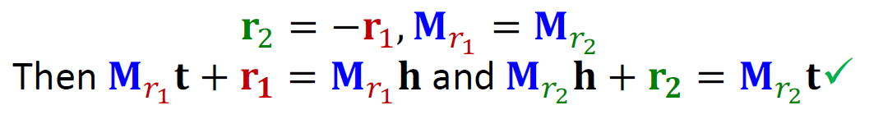
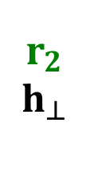
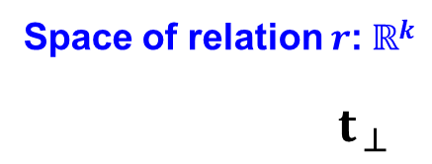
Inverse Relations:
𝑟₂(ℎ, 𝑡) ⇒ 𝑟₁(𝑡, ℎ)
Example : (Advisor, Advisee)
TransR can model inverse relations
𝐫: = −𝐫;, 𝐌_{8?} = 𝐌_{8@}
Then 𝐌_{8?} 𝐭 + 𝐫_{𝟏} = 𝐌_{8?} 𝐡 and 𝐌_{8@} 𝐡 + 𝐫_{𝟐} = 𝐌_{8@} 𝐭✓
Space of entities: ℝ^{𝒅}
𝐭
𝐌_{r1} = 𝐌_{r2}
𝐡
Space of relation 𝒓: ℝ^{𝒌}
${\text{t}}_{⊥}$
𝐫_{𝟏}
𝐫_{𝟐}
$${\text{h}}_{⊥}$$
52

Slide 29
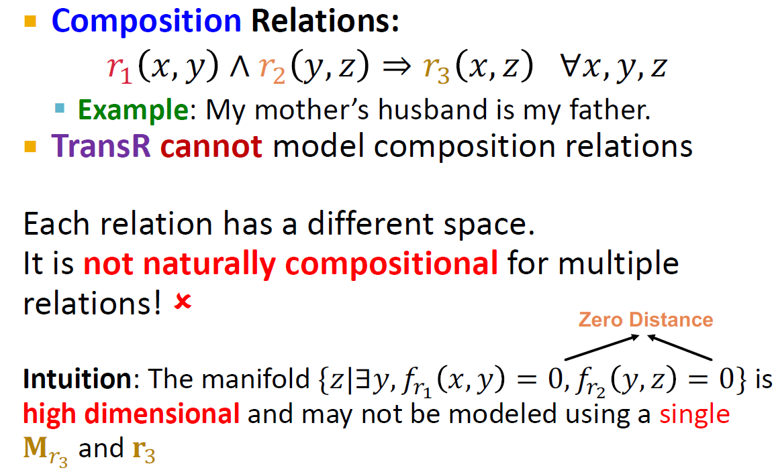
Composition Relations:
𝑟" 𝑥, 𝑦 ∧ 𝑟# 𝑦, 𝑧 ⇒ 𝑟/ 𝑥, 𝑧 ∀𝑥, 𝑦, 𝑧
Example: My mother’s husband is my father.
TransR cannot model composition relations
Each relation has a different space.
It is not naturally compositional for multiple
relations! ✗
Zero Distance
Intuition: The manifold {𝑧|∃𝑦, 𝑓*@ 𝑥, 𝑦 = 0, 𝑓_{*A} 𝑦, 𝑧 = 0} is
high dimensional and may not be modeled using a single
𝐌_{r3} and 𝐫₃

Slide 30
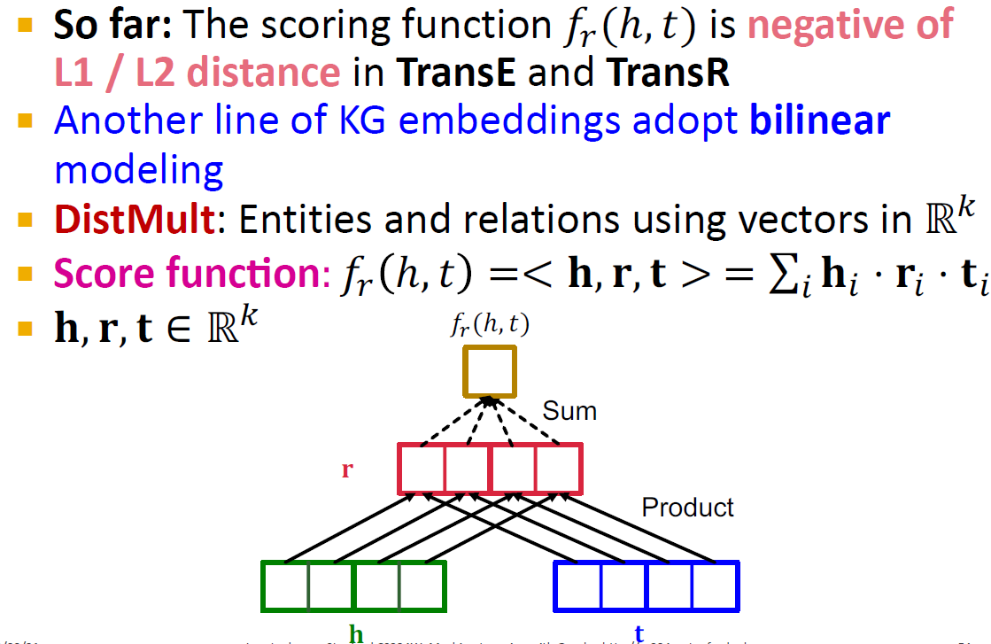
Yang et al, Embedding Entities and Relations for Learning and Inference in Knowledge Bases, ICLR 2015
So far: The scoring function 𝑓₈(ℎ, 𝑡) is negative of L1 / L2 distance in TransE and TransR
Another line of KG embeddings adopt bilinear
modeling
DistMult: Entities and relations using vectors in ℝ⁷
Score funcMon: 𝑓₈ ℎ, 𝑡 =< 𝐡, 𝐫, 𝐭 > = ∑> 𝐡> ⋅ 𝐫> ⋅ 𝐭>
𝐡, 𝐫, 𝐭 ∈ ℝ⁷
𝑓!(ℎ, 𝑡)
Sum
𝐫
Product
𝐡
𝐭

Slide 31

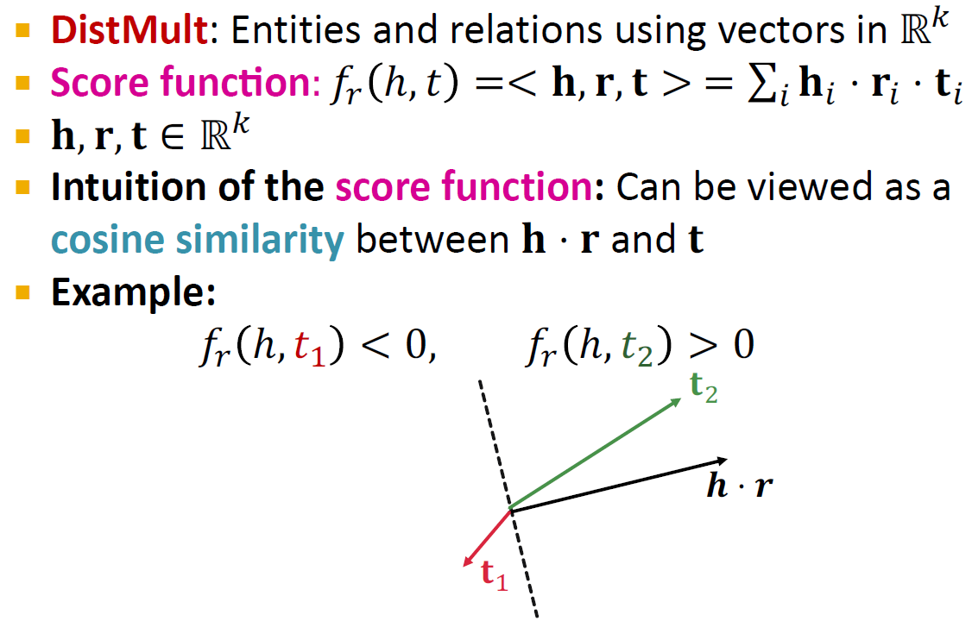
DistMult: Entities and relations using vectors in ℝ⁷
Score funcMon: 𝑓₈ ℎ, 𝑡 =< 𝐡, 𝐫, 𝐭 > = ∑> 𝐡> ⋅ 𝐫> ⋅ 𝐭>
𝐡, 𝐫, 𝐭 ∈ ℝ⁷
Intuition of the score function: Can be viewed as a
cosine similarity between 𝐡 ⋅ 𝐫 and 𝐭
Example:
𝑓₈ ℎ, 𝑡; < 0, 𝑓₈ ℎ, 𝑡: > 0
𝐭*
𝒉 ⋅ 𝒓
𝐭₎

Slide 32
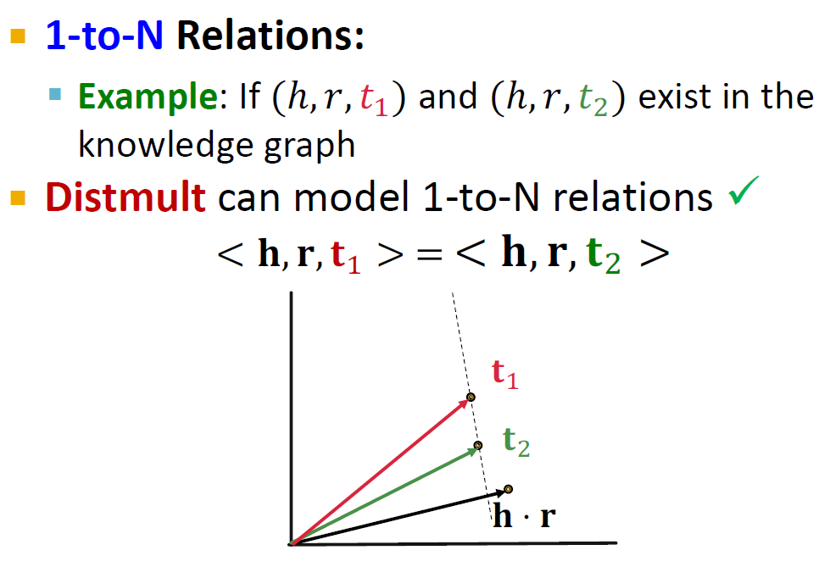
1-to-N Relations:
Example: If (ℎ, 𝑟, 𝑡₍) and (ℎ, 𝑟, 𝑡₇) exist in the knowledge graph
Distmult can model 1-to-N relations ✓
< 𝐡, 𝐫, 𝐭₍ > = < 𝐡, 𝐫, 𝐭# >
𝐭₎
𝐭*
𝐡 ⋅ 𝐫

Slide 33
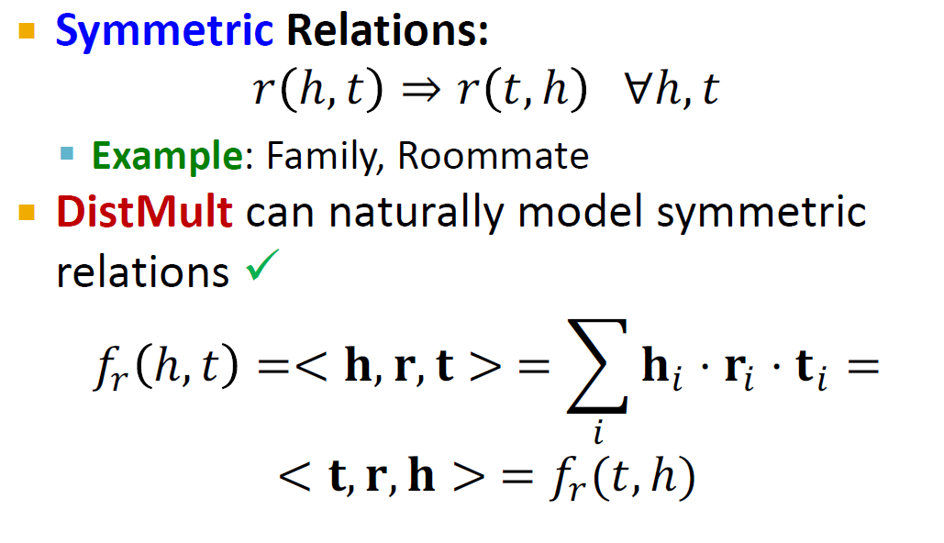
Symmetric Relations:
𝑟 ℎ, 𝑡 ⇒ 𝑟 𝑡, ℎ ∀ℎ, 𝑡
Example: Family, Roommate
DistMult can naturally model symmetric relations ✓
=< 𝐡, 𝐫, 𝐭 > = M 𝐡₃ ⋅ 𝐫₃ ⋅ 𝐭₃ =
3
< 𝐭, 𝐫, 𝐡 > = 𝑓!(𝑡, ℎ)
𝑓! ℎ, 𝑡

Slide 34
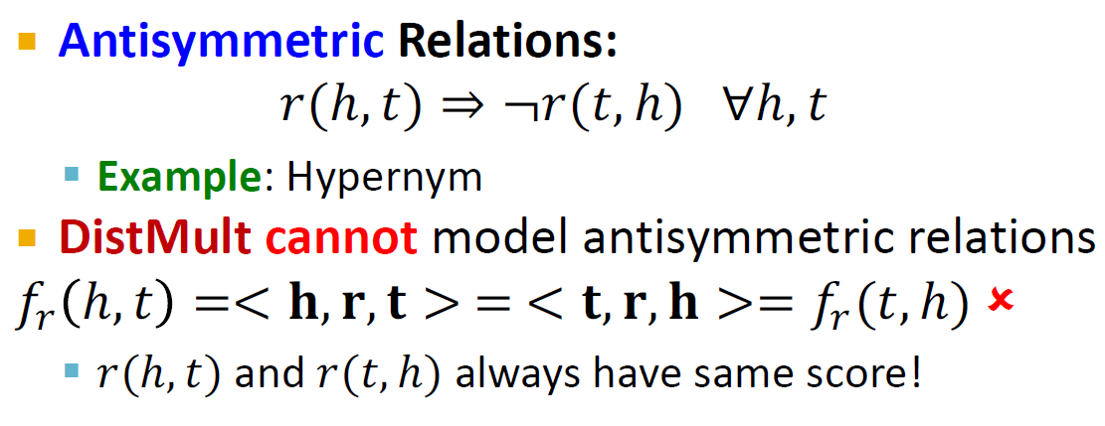
Antisymmetric Relations:
𝑟(ℎ, 𝑡) ⇒ ¬𝑟(𝑡, ℎ) ∀ℎ, 𝑡
Example: Hypernym
DistMult cannot model antisymmetric relations
𝑓! ℎ, 𝑡 =< 𝐡, 𝐫, 𝐭 > = < 𝐭, 𝐫, 𝐡 >= 𝑓!(𝑡, ℎ) ✗
𝑟(ℎ, 𝑡) and 𝑟(𝑡, ℎ) always have same score!

Slide 35
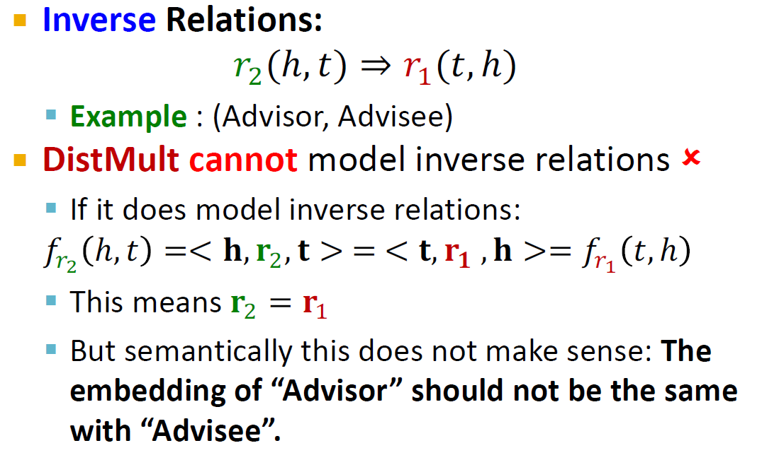
Inverse Relations:
𝑟#(ℎ, 𝑡) ⇒ 𝑟"(𝑡, ℎ)
Example : (Advisor, Advisee)
DistMult cannot model inverse relations ✗
If it does model inverse relations:
𝑓_{*3} ℎ, 𝑡 =< 𝐡, 𝐫₇, 𝐭 > = < 𝐭, 𝐫_{𝟏} , 𝐡 >= 𝑓_{*4} 𝑡, ℎ
This means 𝐫₇ = 𝐫₍
But semantically this does not make sense: The embedding of “Advisor” should not be the same with “Advisee”.

Slide 36
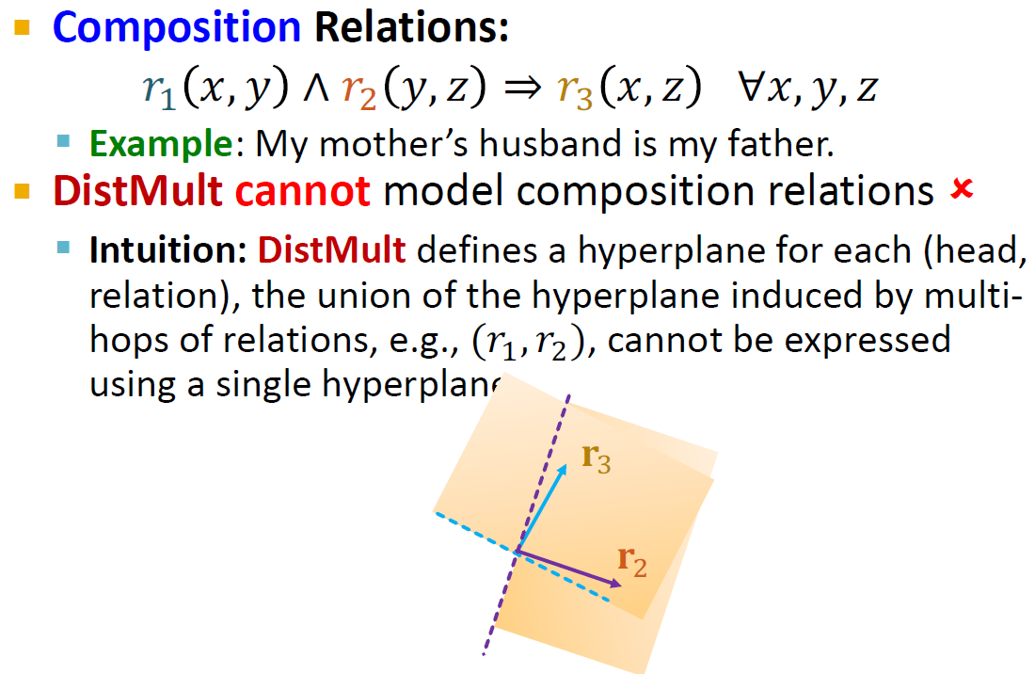


Composition Relations:
𝑟; 𝑥, 𝑦 ∧ 𝑟: 𝑦, 𝑧 ⇒ 𝑟? 𝑥, 𝑧 ∀𝑥, 𝑦, 𝑧
Example: My mother’s husband is my father.
DistMult cannot model composition relations ✗
Intuition: DistMult defines a hyperplane for each (head, relation), the union of the hyperplane induced by multi- hops of relations, e.g., (𝑟., 𝑟/), cannot be expressed using a single hyperplane.
𝐫₊
𝐫*

Slide 37

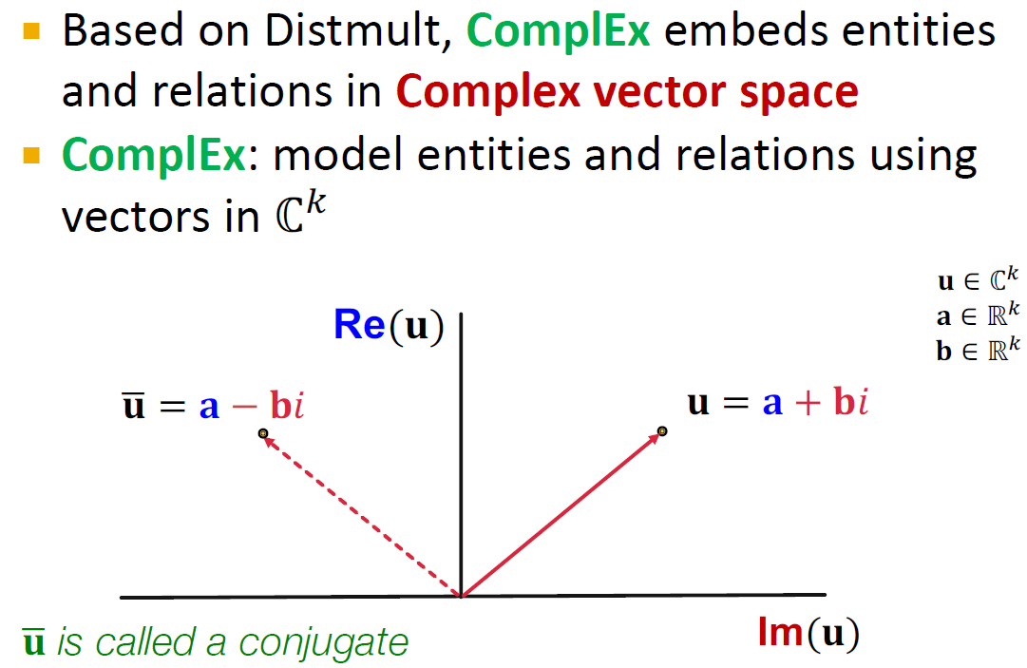
Trouillon et al, Complex Embeddings for Simple Link Prediction, ICML 2016
Based on Distmult, ComplEx embeds entities and relations in Complex vector space
ComplEx: model entities and relations using vectors in ℂ⁰
𝐮 ∈ ℂ.
𝐚 ∈ ℝ.
𝐛 ∈ ℝ.
Re(𝐮)
𝐮7 = 𝐚 − 𝐛𝑖
𝐮 = 𝐚 + 𝐛𝑖
𝐮7 is called a conjugate
Im(𝐮)

Slide 38
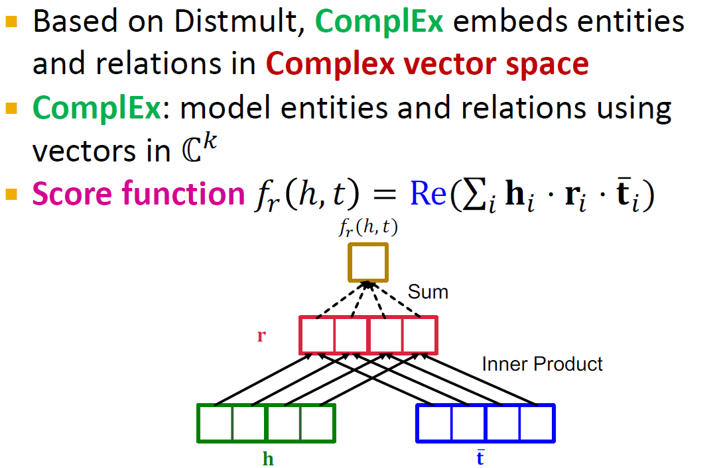
Based on Distmult, ComplEx embeds entities and relations in Complex vector space
ComplEx: model entities and relations using vectors in ℂ⁰
Score function 𝑓! ℎ, 𝑡 = Re(∑₃ 𝐡₃ ⋅ 𝐫₃ ⋅ 𝐭̅₃ )
𝑓!(ℎ, 𝑡)
Sum
𝐫
Inner Product
𝐡
𝐭

Slide 39
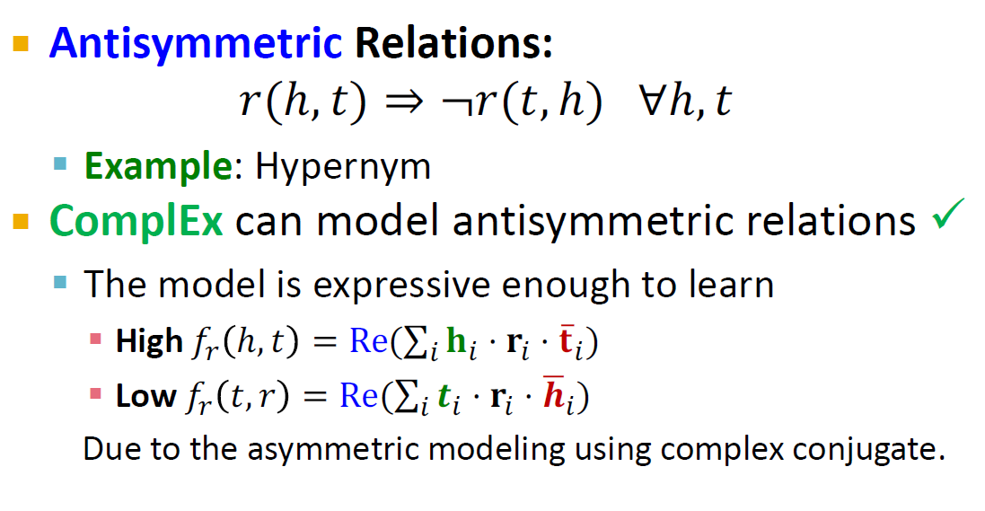

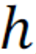
Antisymmetric Relations:
𝑟(ℎ, 𝑡) ⇒ ¬𝑟(𝑡, ℎ) ∀ℎ, 𝑡
Example: Hypernym
ComplEx can model antisymmetric relations ✓
The model is expressive enough to learn
High 𝑓/ ℎ, 𝑡 = Re(∑_{N} 𝐡_{N} ⋅ 𝐫_{N} ⋅ 𝐭̅_{N})
Low 𝑓/ 𝑡, 𝑟 = Re(∑_{N} 𝒕_{N} ⋅ 𝐫_{N} ⋅ 𝒉^{O}_{N})
Due to the asymmetric modeling using complex conjugate.

Slide 40
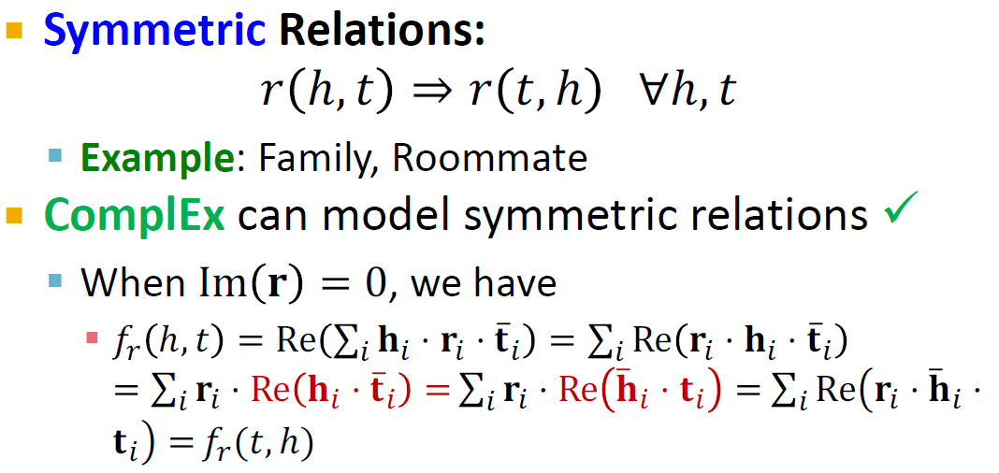
Symmetric Relations:
𝑟 ℎ, 𝑡 ⇒ 𝑟 𝑡, ℎ ∀ℎ, 𝑡
Example: Family, Roommate
ComplEx can model symmetric relations ✓
When Im 𝐫 = 0, we have
𝑓/ ℎ, 𝑡 = Re ∑_{N} 𝐡_{N} ⋅ 𝐫_{N} ⋅ 𝐭̅_{N} = ∑_{N} Re 𝐫_{N} ⋅ 𝐡_{N} ⋅ 𝐭̅_{N}
= ∑_{N} 𝐫_{N} ⋅ Re 𝐡_{N} ⋅ 𝐭̅_{N} = ∑_{N} 𝐫_{N} ⋅ Re 𝐡̅ _{N} ⋅ 𝐭_{N} = ∑_{N} ReQ𝐫_{N} ⋅ 𝐡̅ _{N} ⋅
𝐭_{N}R = 𝑓/(𝑡, ℎ)

Slide 41
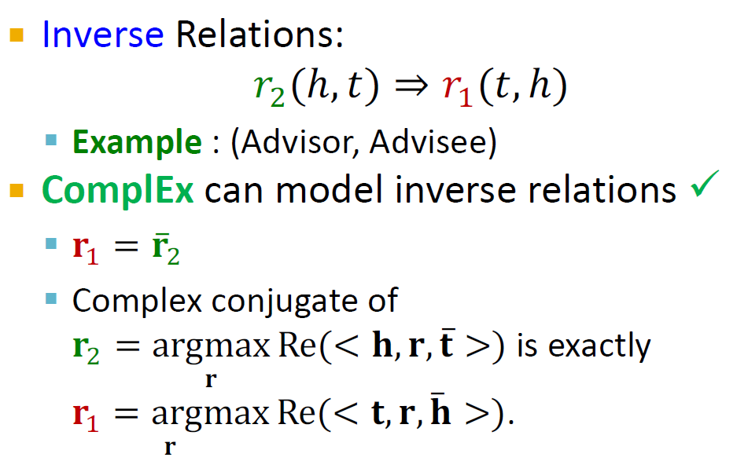
Inverse Relations:
𝑟#(ℎ, 𝑡) ⇒ 𝑟"(𝑡, ℎ)
Example : (Advisor, Advisee)
ComplEx can model inverse relations ✓
𝐫₍ = 𝐫₇
Complex conjugate of
𝐫₇ = argmax Re(< 𝐡, 𝐫, 𝐭̅ >) is exactly
𝐫
𝐫₍ = argmax Re(< 𝐭, 𝐫, 𝐡
𝐫
̅ >).

Slide 42
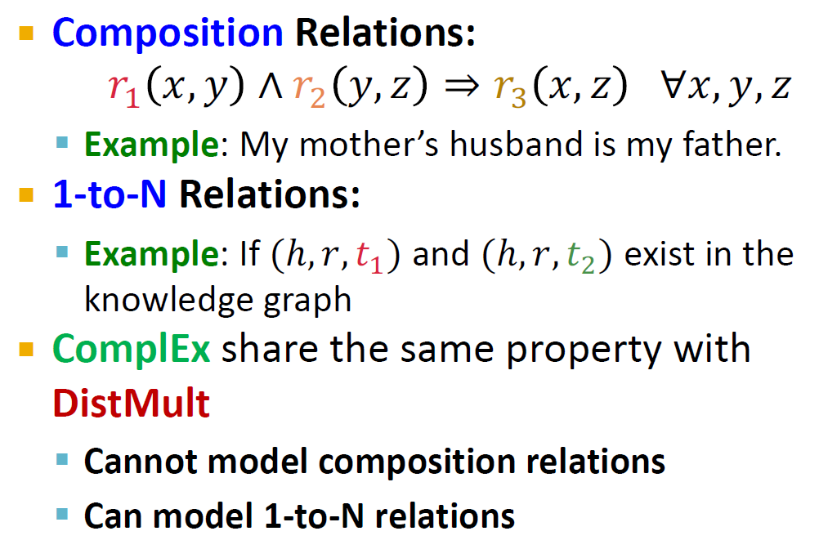
Composition Relations:
𝑟" 𝑥, 𝑦 ∧ 𝑟# 𝑦, 𝑧 ⇒ 𝑟/ 𝑥, 𝑧 ∀𝑥, 𝑦, 𝑧
Example: My mother’s husband is my father.
1-to-N Relations:
Example: If (ℎ, 𝑟, 𝑡₍) and (ℎ, 𝑟, 𝑡₇) exist in the knowledge graph
ComplEx share the same property with
DistMult
Cannot model composition relations
Can model 1-to-N relations

Slide 43
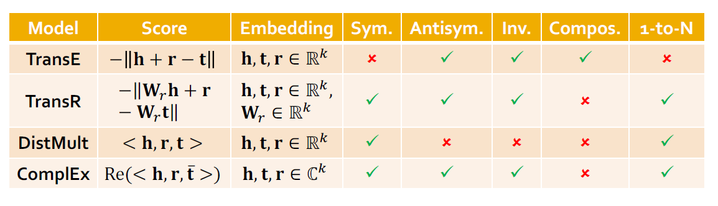
Properties and expressive power of different KG completion methods:
Model | Score | Embedding | Sym. | Antisym. | Inv. | Compos. | 1-to-N
TransE | − 𝐡 + 𝐫 − 𝐭 | 𝐡, 𝐭, 𝐫 ∈ ℝ. | ✗ | ✓ | ✓ | ✓ | ✗
TransR | −‖𝐖!𝐡 + 𝐫 − 𝐖!𝐭‖ | 𝐡, 𝐭, 𝐫 ∈ ℝ., 𝐖! ∈ ℝ. | ✓ | ✓ | ✓ | ✗ | ✓
DistMult | < 𝐡, 𝐫, 𝐭 > | 𝐡, 𝐭, 𝐫 ∈ ℝ. | ✓ | ✗ | ✗ | ✗ | ✓
ComplEx | Re(< 𝐡, 𝐫, 𝐭̅ >) | 𝐡, 𝐭, 𝐫 ∈ ℂ. | ✓ | ✓ | ✓ | ✗ | ✓

Slide 44
1. Different KGs may have drastically different relation patterns!
Sun et al, RotatE: Knowledge Graph Embedding by Relational Rotation in Complex Space, ICLR 2019
There is not a general embedding that works for all KGs, use the table to select models
Try TransE for a quick run if the target KG does not have much symmetric relations
Then use more expressive models, e.g.,
ComplEx, RotatE (TransE in Complex space)

Slide 45
Link prediction / Graph completion is one of the prominent tasks on knowledge graphs
Introduce TransE / TransR / DistMult / ComplEx models with different embedding space and expressiveness

